Slide 1
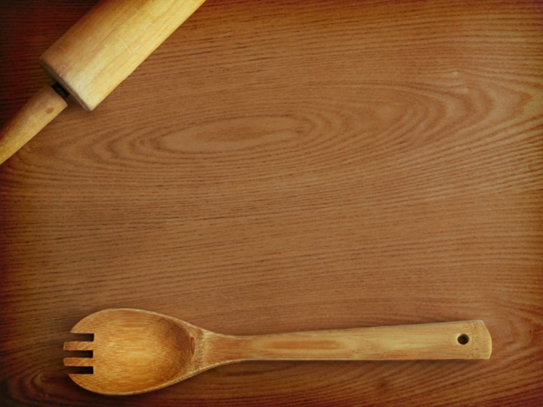
SEQUENCE WORDS

Slide 2
BEGINNING AN IDEA
In the beginning
It all started when
First
Once upon a time
To began
To start
Once
First of all
One day

Slide 3
CONTINUING AN IDEA
After awhile
Soon
Meanwhile
Suddenly
All of a sudden
Next
Then
Second
After that
Later
At the moment
Before long
Eventualy
Afterward
At this point
After that

Slide 4
ENDING AN IDEA
At last
Finally
In the end
Afterward
Last
After all
Lastly
By the end
By this point

Slide 5


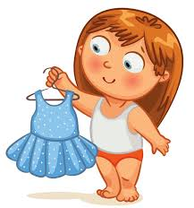
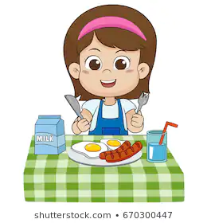
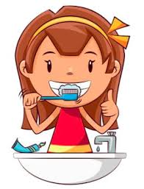
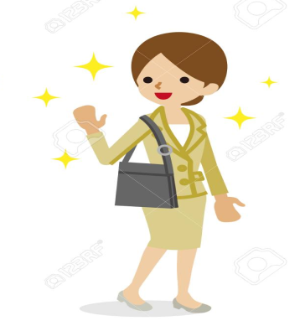
First, I wake up.
Then, I take a shower and get dressed.
After that, I have breakfast.
Next, I brush my teeth.
Finally, I go to work

Slide 6
First, .....................
Then, .....................
After that, .....................
Next, .....................
Finally, .....................

Slide 7
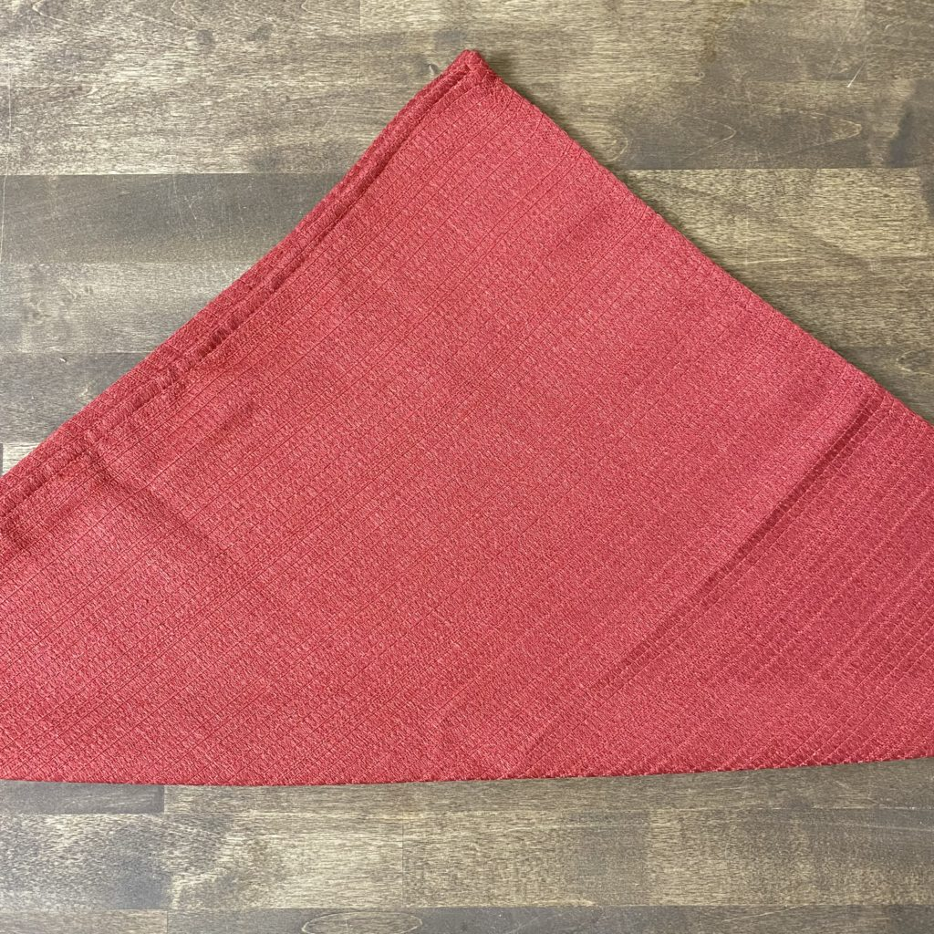
How to Fold Cloth Napkins Into Roses
First, open the cloth napkin up so it lays flat on the surface you are working on. Then, bring one corner of the napkin to the opposite side, creating a triangle.

Slide 8
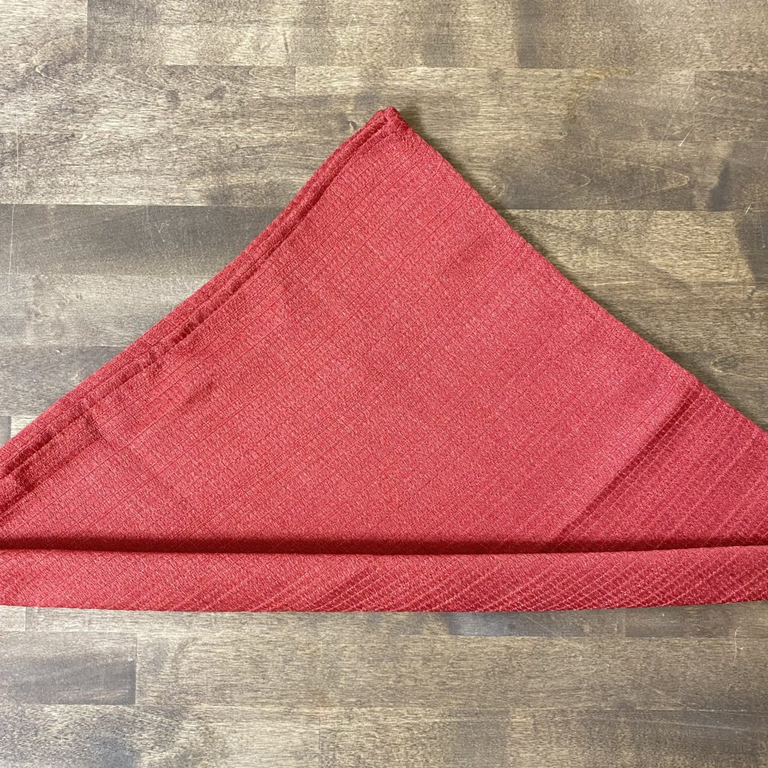
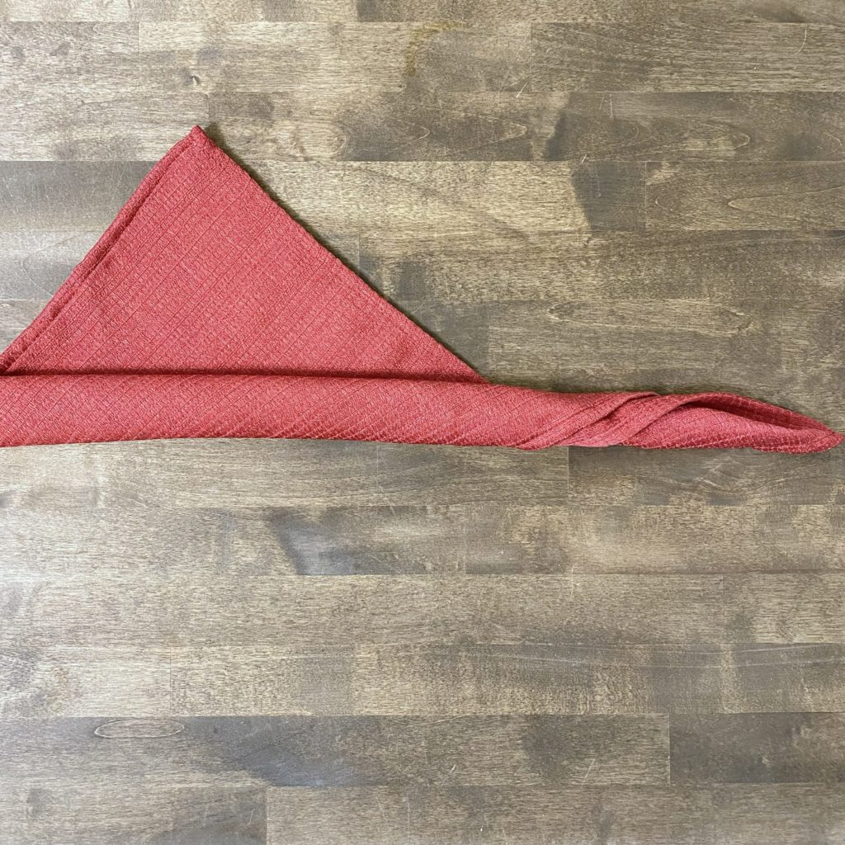
How to Fold Cloth Napkins Into Roses
Then,Begin rolling up the napkin from the bottom fold; going about two-thirds of the way up leaving a 4 to 5-inch triangle at the top.

Slide 9
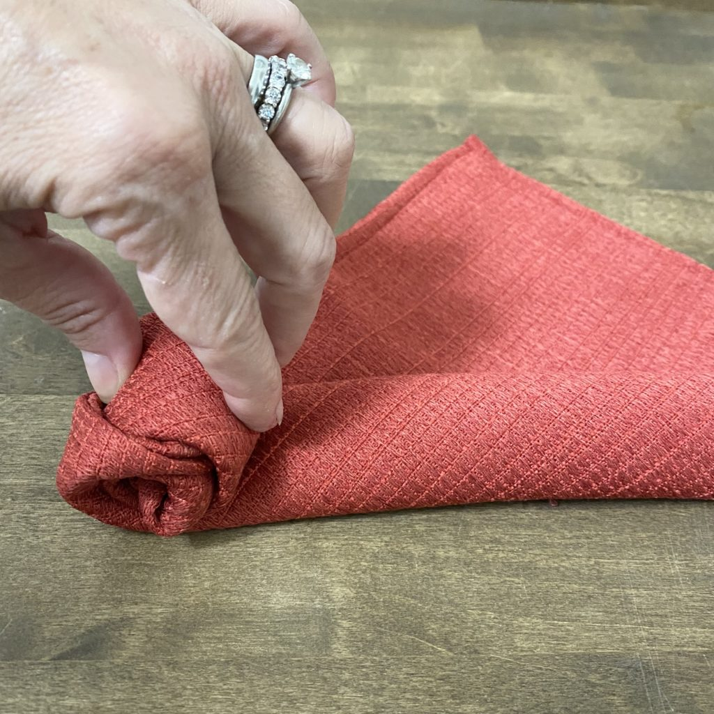
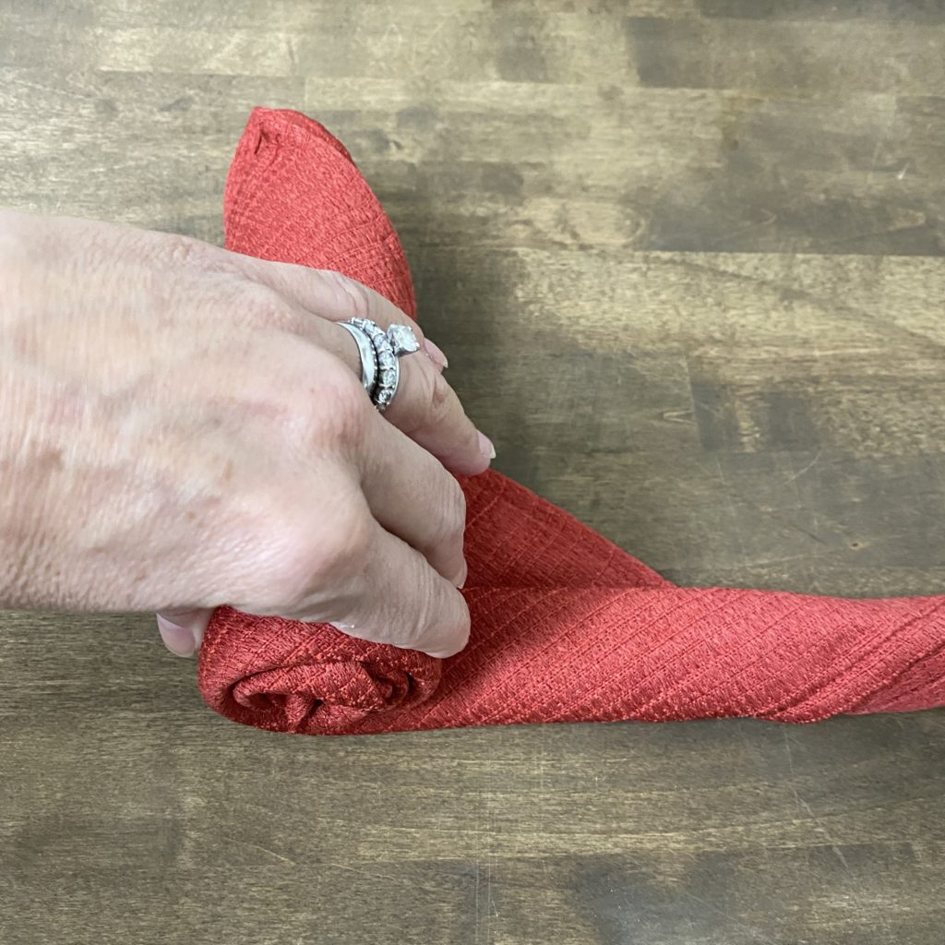
How to Fold Cloth Napkins Into Roses
Next, From one end of the roll, tuck in the edge and carefully begin rolling the napkin all the way to the other side leaving about 4 to 5 inches at the end.

Slide 10
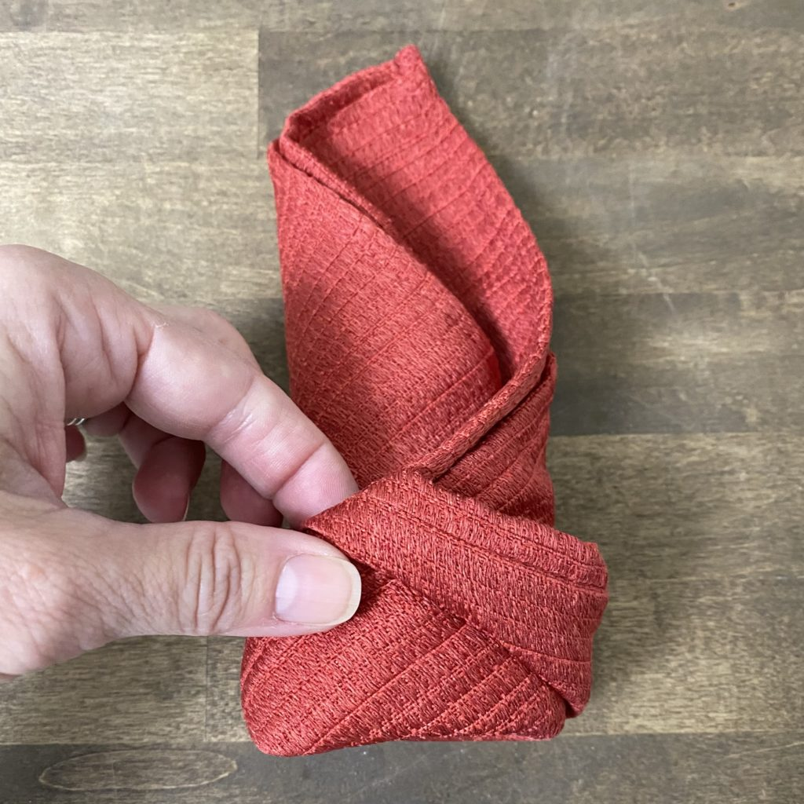
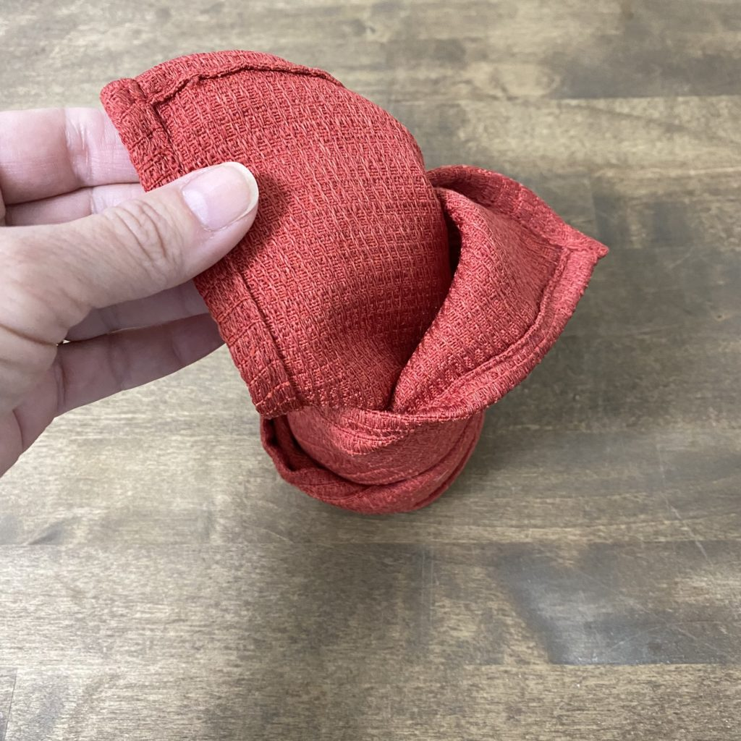
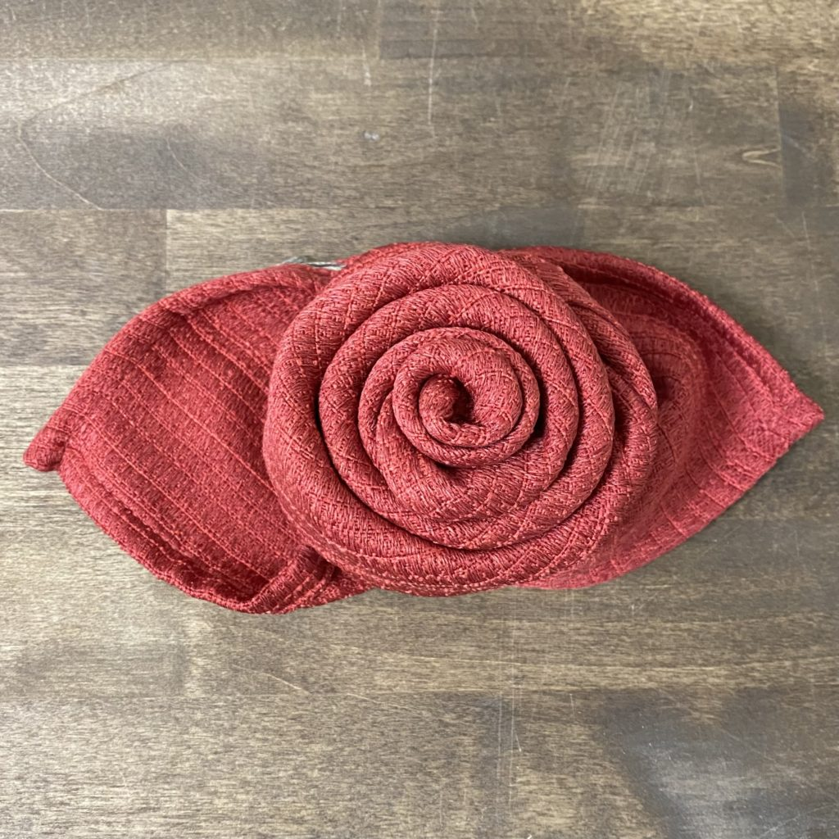
How to Fold Cloth Napkins Into Roses
Finally, tuck the end of the roll into the pocket at the bottom. This will secure the roll in place.

